Slide 1
DocClassifier
Payman Janbakhsh

Slide 2
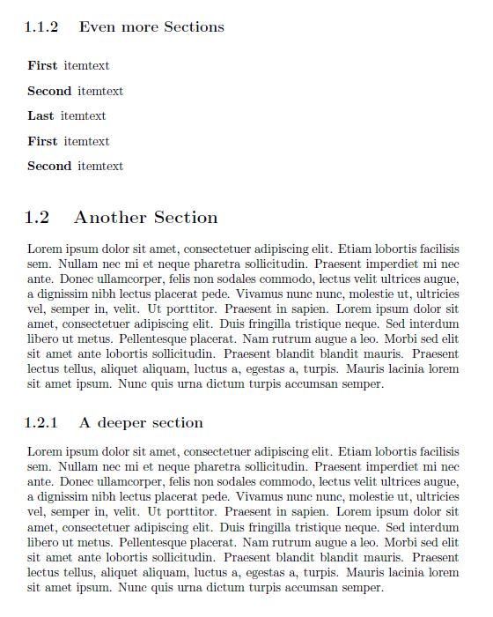

Slide 3
?

Slide 5
Project Objective
Segmentation of documents into text classes

Slide 6
Thomson Reuters
Process legal contracts, and extract important information from the documents
Point of contact: Robert Rankin (TR Tech, Content & Ops)

Slide 7
Project overview & expectation
· To automate the data extraction stage through Segmentation of the documents into text classes such as:
¨ body-text
¨ titles/headings
¨ footers/headers/pagination
¨ tables
¨ signatures/seals.

Slide 8
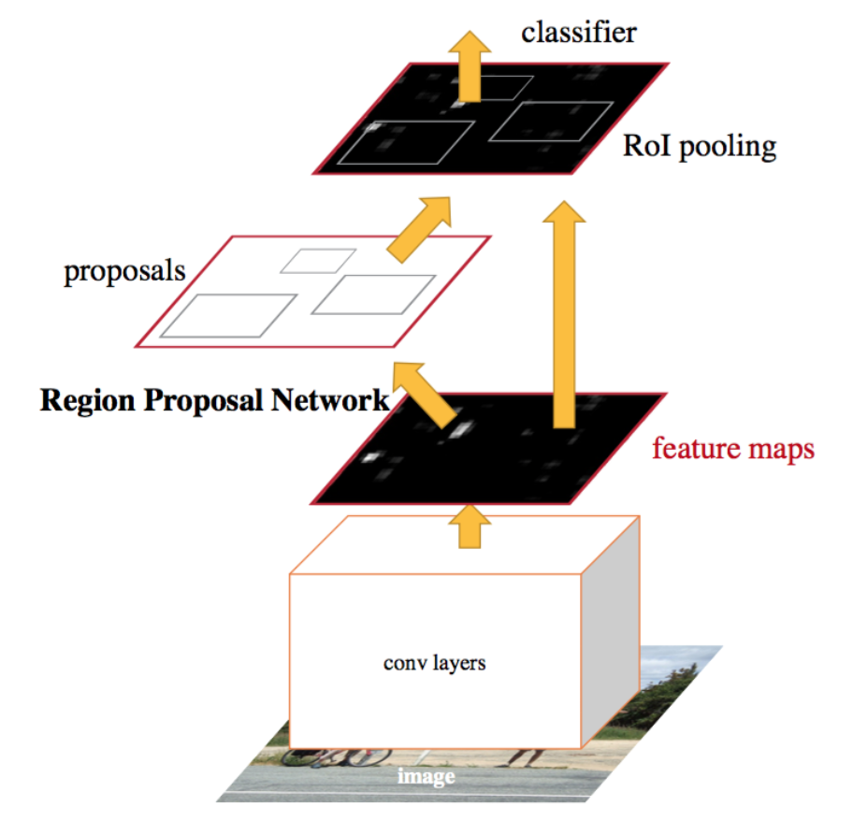
Approach
Using a combination of ML/DNN algorithms
1. NLP-based classifiers
i. Struggle with segments like lists and bullet points
ii. Model must be trained and tested on the same doc style
2. CNN-based classifiers
i. Intuitive like human vision classifier
ii. Same model can be tested on any vocab document

Slide 9
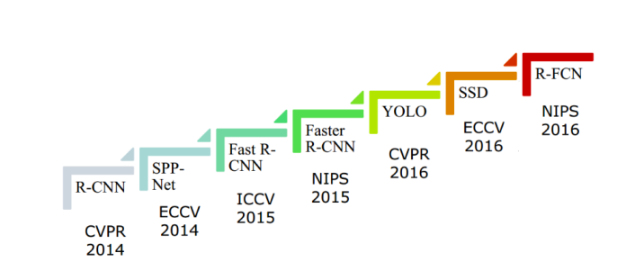
CNN-based models

Slide 10
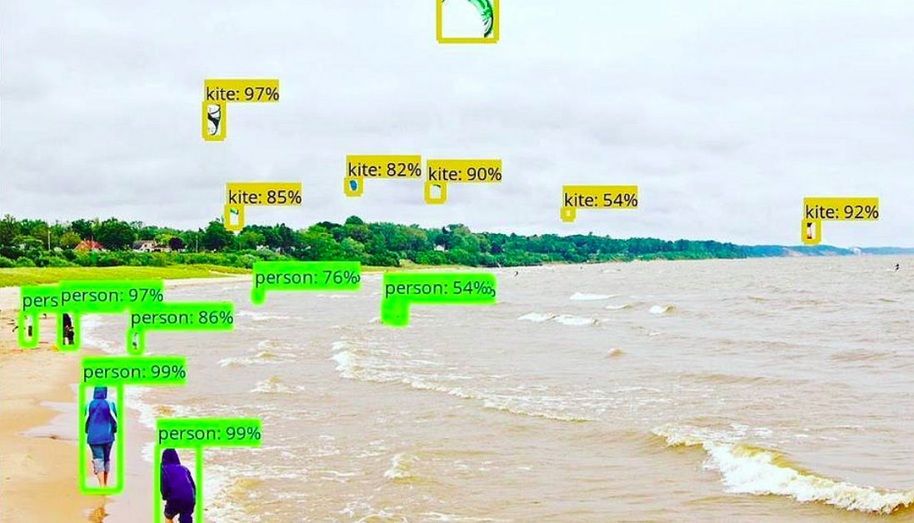
Object detection

Slide 11
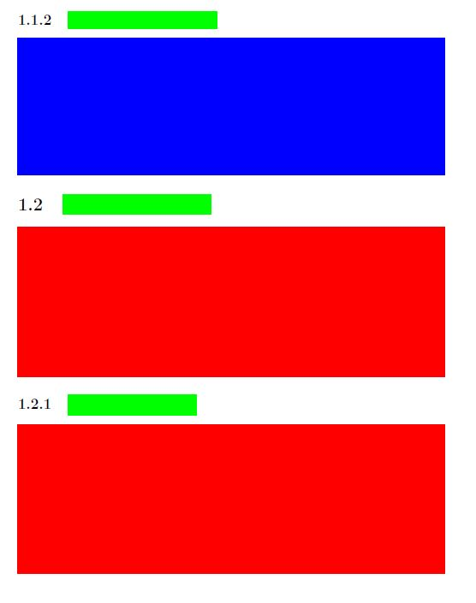
Data
PDF files
1
Single pdf pages single jpg files
Each page to be segmented into classes (labels)
2

Slide 12
Steps
i. Automating the labeling stage given the short timeline for completion
ii. Identifying the right model prior to training, due to computational expense of these models
iii. Model training/validation, and testing on unseen document
iv. Encapsulating the trained model into a user-friendly application

Slide 13
Validation
20 legal documents to be segmented into multiple text sections
Accuracy be measured by Recall, Precession, and F1score

Slide 14
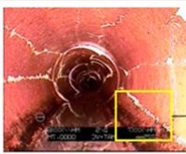
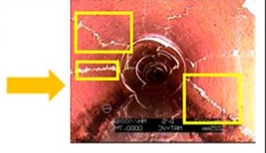
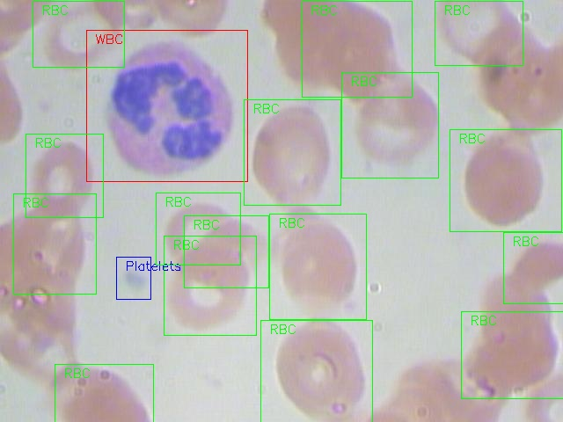
Application
Object detection in any field

Slide 15
Project timeline
Week 1
Week 2
Week 3
Week 4
Week 5
Week 6
Project selection
Data collection
Model set up
Training
Evaluation and tuneup
App development

Slide 16
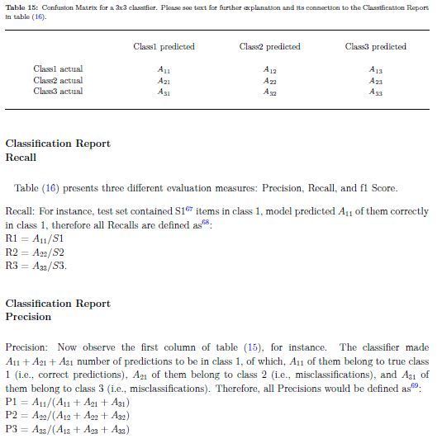
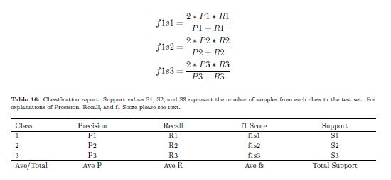
Recall
Precision
F1Score

Slide 17
Image credits
https://medium.com/@ksuryaremanan/beginners-guide-to-object-detection-algorithms-6620fb31c375

